Slide 1

Chapter 3
Positive Emotional Experiences

Slide 2
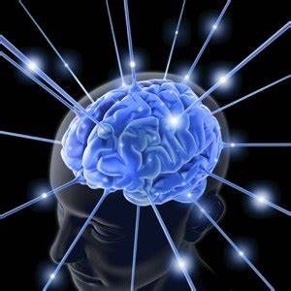
If you could take a pill that made you happy all the time, would you take it?

Slide 3
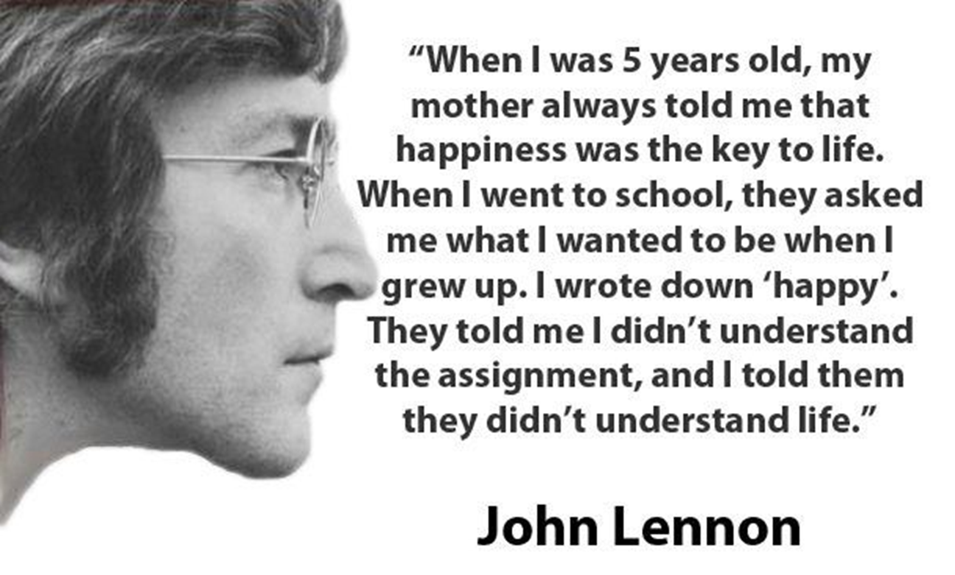

Slide 4

Why do positive emotions matter?
It feels good to experience positive emotions
Positive emotions shape our personalities
Most people say happiness is important to them
Positive emotions are related to good outcomes
  Longevity
  Physical health
  Social relationships
  Cognitive outcomes

Slide 5
Why do positive emotions matter?
Alice Isen, Cornell University
  When experiencing mild positive emotions, people are more likely to:
  help others
  be flexible in their thinking
  better problem-solve
  more willing to exhibit self-control

Slide 6

Why do positive emotions matter?
When experiencing positive affective experiences, we tend to engage in more approach oriented behaviors, and when experiencing negative affective experiences, we tend to engage in more avoidance behaviors

Slide 7

Broaden and Build Theory of Positive Emotions
Barbara Fredrickson

Slide 8
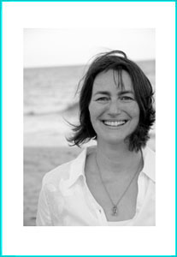
Broaden and Build -- Broaden
Barbara Fredrickson
Positive emotions broaden thinking about possible actions – opening awareness to a larger range of thoughts and actions than is typical
Positive emotions linked to specific behavioral action tendencies
  Joy – urge to play and be creative
  Interest – urge to explore and learn
  Serenity – urge to savor and integrate
Notes:
When we experience a negative emotion, our response options narrow and we act with haste to avoid danger
Positive emotions signal safety and our response is to broaden our response repertoire and build on them **It’s a Wonderful Life Clip of running through the streets**
Perhaps it is evolutionarily advantageous to experience positive emotions because they lead us to engage in activities that add to our behavioral and cognitive repertoires
In laboratory, participants induced to experience positive emotions showed broader attention, greater working memory, enhanced verbal fluency, and increased openness to information
Fredrickson and Branigan showed college students clips to induce amusement, contentment, anger, or anxiety
Tested with a global-local visual processing task which required them to match abstract stimuli with one another
The could attend to local (small) features or global (large) features
Induction of positive emotions resulted in more attention to broader (more global) details
Second study with same induction, participants induced with positive emotions answered more diversely in response to a 20-questions task
Positive emotions can “un-do” the physiological effects of negative emotions
Participants told to prepare a 1-minute speech on “why you are a good friend” that would be videotaped and rated by peers
Hooked up to physiological measurement to record heart rate, blood pressure, and peripheral vasoconstriction – indices of anxiety and sympathetic nervous system arousal
Following the preparation time, participants saw one of four different film clips: joy, contentment, sadness, emotionally neutral
None of the films had any effect on sympathetic arousal
But individuals who saw the positive film (joy or contentment) retuned to normal more quickly than other participants
The positive emotions “undid” the anxiety that had been induced by the experiment
Replicated with viewing a fear-inducing film and then one of these other films
Freud postulated that people use humor in dire situations to bolster their spirits – gallows humor

Slide 9
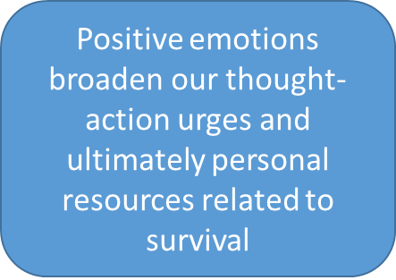
Broaden and Build -- Broaden
Personal resources
Cognitive
Interpersonal
Physical
Intellectual

Slide 10
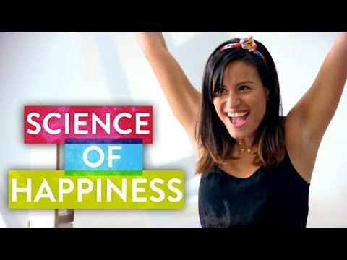
Broaden and Build
Why Happy People Do it Better | The Science of Happiness - YouTube

Slide 11
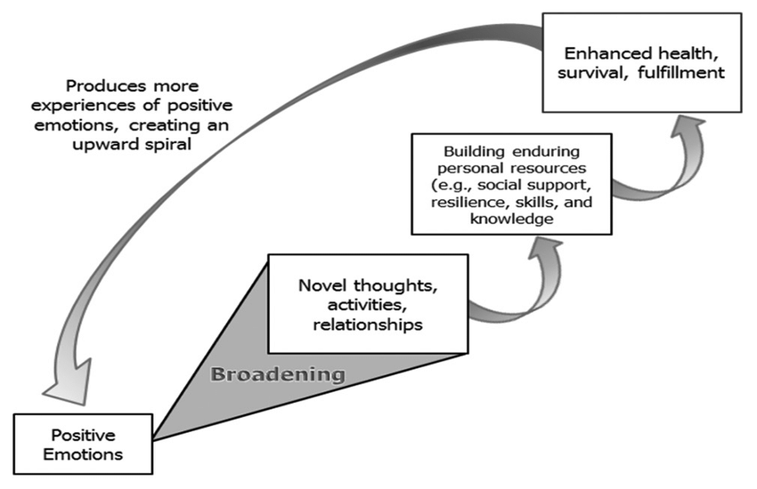

Slide 12
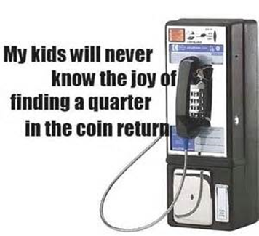
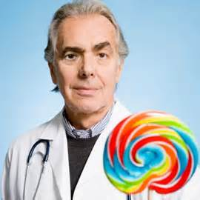
Thinking broadly
Isen Research Study 1
  Put coins in pay phones and then asked those that found a coin for help
Isen Research Study 2
  Give physicians a bag of candy
  Candy = more cognitive flexibility in case conceptualization; superior reasoning and decision making

Slide 13
Broaden and Build -- Build
Positive emotions related to survival and reproduction on a larger time scale
Positive emotions → expansive awareness → building resources → better equipped to handle later threats
Notes:
Negative emotions – immediate consequences; Positive emotions -

Slide 14
Resources Garnered in the Build
Learning (Cognitive resources)
Relationships (Social resources)
Fighting and foraging skills, improving cardiovascular health (Physical resources)
Other positive emotions like more hopeful and resilient (Psychological resources)
Neural growth (Neural resources)
Notes:
Physical health, longevity,

Slide 15

Well-Being Journal Entry #6
Consider Broaden and Build Theory
Person-Activity Fit: To raise positive emotion, DO something that will boost your positive emotion. Describe one thing you are looking forward to DOING:
What 3 conscious acts of kindness will you do today?

Slide 16

What are the benefits of positive emotions and other affective experiences?
Mortality

Slide 17
The Nun Study – Danner et al.
Asked to write 2 to 3 page autobiographical sketch as part of vows
Nuns were about 22 years old on average
Coded with positive-, negative-, and neutral-emotion words and sentences
Very few had negative emotions

Slide 18
Nun Study Survival Curve

Slide 19
Since the Nun Study….
Meta-analytic evidence suggests a link between mortality and subjective well-being
  Martín-María et al. (2017) reviewed 62 studies with 1,259,949 participants
    Stronger for men than women
  Chida and Steptoe (2008) 56 studies in samples of both healthy participants and those with existing disease from many countries (representing Asia, Australia, Europe, and North America)
    association between both positive emotions and positive affectivity and mortality in both healthy and diseased samples, independent of negative affect

Slide 20
However,
UK Million Women Study (Liu, Floud, Pirie, Green, Peto, & Beral, 2015)
Women between 50 – 69 followed for ten years
39% happy most of the time
44% usually happy
17% unhappy
Unhappy group had higher rates of mortality
When accounting for self-rated health, demographic and lifestyle factors, relationship went away

Slide 21
Synthesis on Mortality Data
Not all positive affect is created equally
Relation between positive affect and mortality is particularly strong when considering “active” positive affect (“I felt active.” Petrie et al. 2017)
Relation between PANAS and mortality
Including age, gender, education, relationship status, smoking, exercise, alcohol consumption, BMI, blood pressure, stroke, diabetes, myocardial infarction in model
I felt active – strongest effect

Slide 22
What are the benefits of positive emotions and other affective experiences?
Physical Health

Slide 23
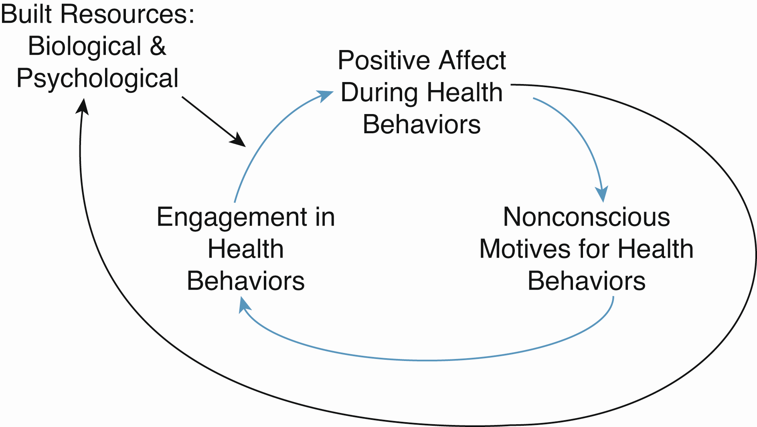
Upward Spiral Theory
Strength Training with Gina
We laugh and joke…positive emotion
We feel better about muscles we are toning
We are more likely to strength train because of the reinforcing nature of the behaviors and positive emotions

Slide 24

Undoing Hypothesis
Negative emotions have particular physiological effects
Induction of positive emotion (vs. sad or neutral) after induction of negative emotion (fearful film or prepare speech) associated with faster return to baseline physiological functioning
  Cardiovascular effects
  Most delay in sadness induction condition
Protective physiological effects
  Rhinovirus infection
Notes:
Nasal spray of rhinovirus or influenza…more positive emotions reported were related to lower occurrence of common cold

Slide 25
Physical Health: Inflammation
Original model:
Higher positive affect lower inflammation
Meditational model
Higher pos lower BMI lower inflammation Higher pos mod exercise lower affect inflammation

Slide 26
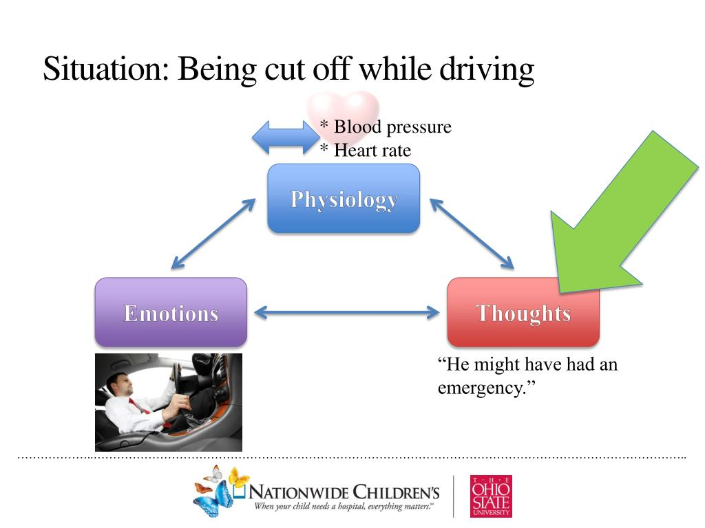
Physical Health:
Cardiovascular Disease
Positive affective experiences associated with decreased risk of cardiovascular disease and better cardiac functioning

Slide 27
What are the benefits of positive emotions and other affective experiences?
Social Relationships

Slide 28

Links
Married people tend to be happier than single
Happy people…
  Have better social relationships
  Tend to be perceived as more likable and cooperative
  Tend to be more socially connected

Slide 29
Mills College Yearbook Study
Harker & Keltner (2001)
1958 and 1960 yearbook pictures
All but three women were smiling
Average Duchenne level on 10-point scale = 3.8
Duchenne level predicted marital status and happiness in marriages
Attractiveness did not predict satisfying relationship

Slide 30
Since then….
Baseball player’s smile intensity predicted how long he lived (Abel & Kruger, 2010) N = 196
Accounting for year of birth, BMI, marital status, college attendance, and length of baseball career
Not smiling = 72.9 years at death
Partial smile = 75.0 years at death
Duchenne = 79.9 years at death
Researchers (N = 440) smiles in photos related to impact, but not quantity, of work (Kaczmarek et al., 2018)

Slide 31

Happiness is Contagious
4,739 people followed over 20 years (1983 – 2003)
Happy and unhappy people clustered together
Happiness spread over time
  If someone in your network becomes happier over time, you are also likely to become happier over time

Slide 32
What are the benefits of positive emotions and other affective experiences?
Cognitive Functioning

Slide 33

Cognitive Functioning: Isen Research
  Positive emotions facilitate memory and promote cognitive flexibility and creativity in problem solving

Slide 34

What are the benefits of positive emotions and other affective experiences?
Money

Slide 35
Positive Affective Experiences and Money
Does having more money make you happier?
Weak relationship between income and happiness
Debt and life satisfaction weakly related
Income more strongly related to life satisfaction than positive affect
At lower levels of income, income is more strongly related to positive affect
Wealthier nations happier than poorer nations
r = 0.12 – 0.24
Less than $75,000

Slide 36
Easterlin Paradox
Even though income has doubled since 1972, happiness is relatively stable

Slide 37
Positive Affective Experiences and Money
2. Does How You Spend Your Money Matter?
Spending money on things shorter happiness boost than spending money on experiences
  Hedonic adaptation
  Experiences: trips, spa, dinner, etc
Spending money on buying back time associated with happiness (e.g., lawn or laundry service)
  Time Scarcity
Spending money on others associated with happiness

Slide 38


Slide 39
World Happiness Report
Proportional contributions of 6 factors in predicting life evaluation across countries

Slide 40
Happiest Countries in the World – Based on Life Evaluation ( 2024)
Rank | Country | Overal Evaluation
1 | Finland | 7.741
2 | Denmark | 7.583
3 | Iceland | 7.525
4 | Sweden | 7.344
5 | Israel | 7.341
6 | Netherlands | 7.319
7 | Norway | 7.302
8 | Luxembourg | 7.122
9 | Switzerland | 7.060
Notes:
Bhutan – Gross National Happiness, proposed World Happiness Day – March 20
US – 19th; 14th in 2017
Finland jumped from 5th to 1st place from 2017 – 2018
Caring, freedom, generosity, honesty, health, income, and good governance
PA predicted by: social support, freedom to make like choices, generosity,
NA predicted by: social support, freedom to make life choices, perceptions of corruption
Neither predicted by health life expectancy at birth or GDP per capita

Slide 41

Well-Being Journal Entry #7
Positivity Ratio (Fredrickson)
https://positivityratio.com/
Take the positive self-test and record in your journal
Include in your journal entry how you could improve your positivity ratio

